Slide 1

Museums Forum 2023
Welcome to Winchester Cathedral
Eleanor Swire
Curator and Librarian
eleanor.swire@winchester-cathedral.org.uk
Notes:
Thank you Stephen and welcome everyone to Winchester Cathedral. It is lovely to see so many of you here for what I think will be a really interesting day. As Stephen said, my name is Ellie and I am the Curator and Librarian here at the Cathedral. I was appointed back in September 2021 and since then, have been in charge of managing and conserving our historic collections, which has proven to be a very challenging but also very rewarding job.

Slide 2
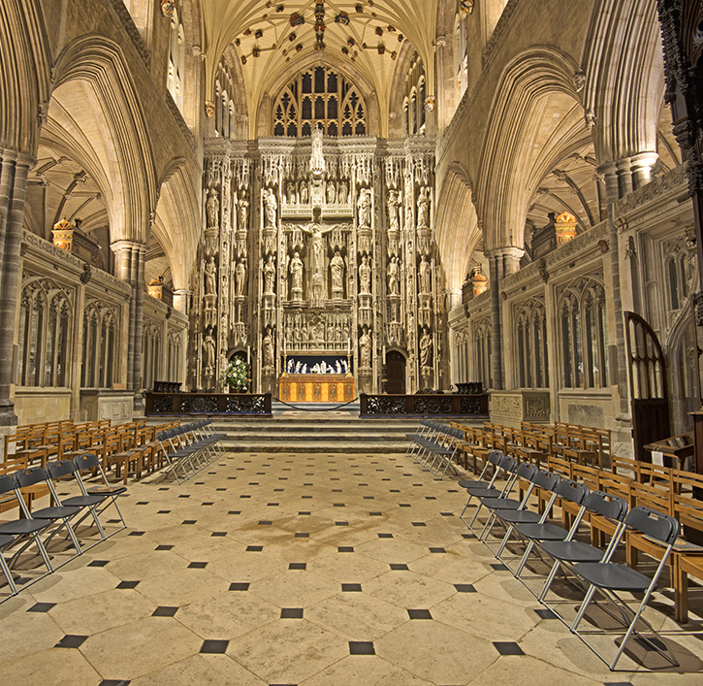
Cathedral as a working building, with function and purpose, as well as a sacred space
Notes:
Now I think the first really obvious but also very important point to note is that the Cathedral is a working building, with its own particular liturgical purpose and function. It is a site of huge historical and cultural significance, with a rich and diverse collection of books and artefacts. But the Cathedral is also a sacred space, with its traditions and practices. People gather daily inside the Cathedral to worship God and the religious resonance of the building and its objects is integral to how we experience and understand it. This means that while we share many of the same concerns and standards as other heritage organisations, we are also in many ways distinct, always seeking to balance the need to protect and preserve items with the wider context in which they are used as part of liturgy.

Slide 3
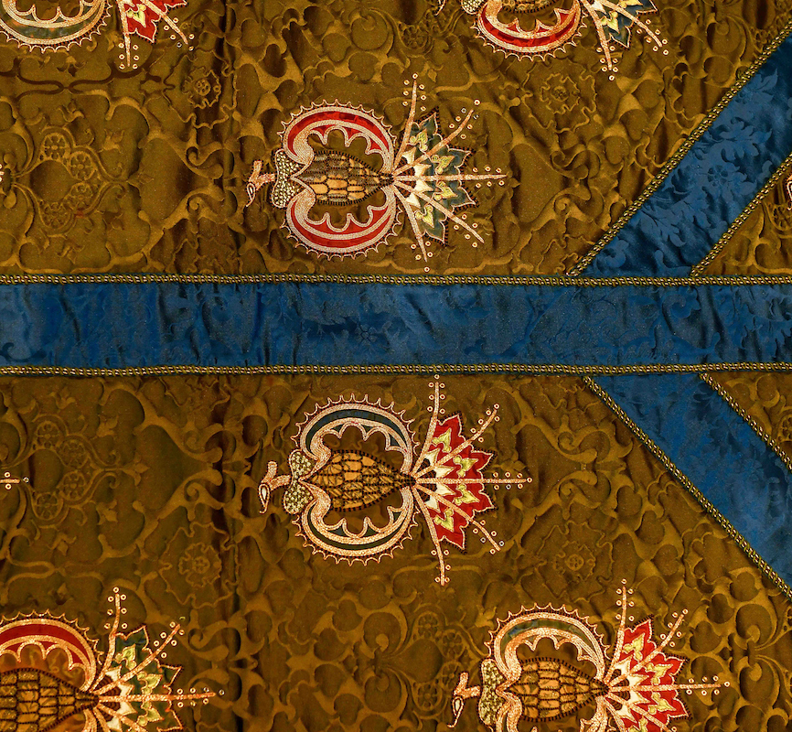
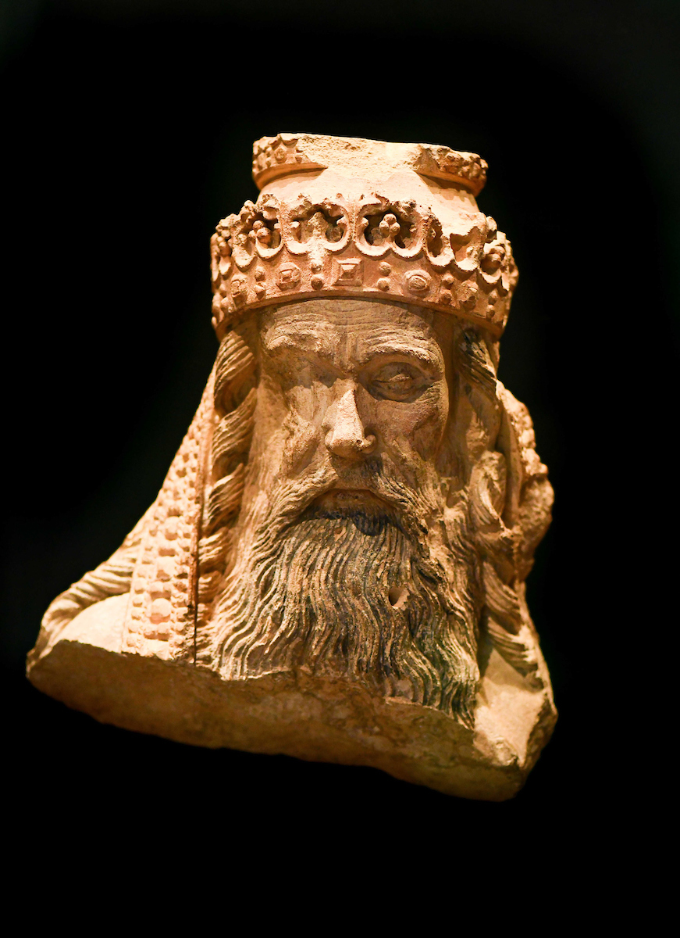
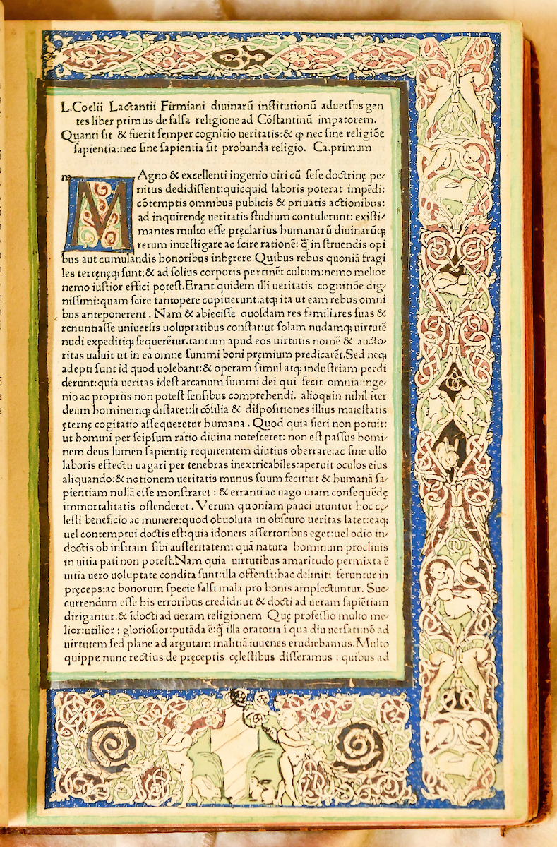
Historic Collections
Notes:
So what type of object might you expect to find in our collections? Well, we have somewhere between 7000-7500 records in our catalogue database, for objects including medieval manuscripts and early printed books, textiles, metalwork, stone sculpture, coins, woodwork, glass and ceramics. Many of these are kept in storage, but others are visible as you walk around the body of the cathedral, part of the fittings and furnishings of the building fabric. From one day to the next, I might work with Roman coins or 13th-century floor tiles, 16th-century books or Victorian altar frontals and vestments.

Slide 4
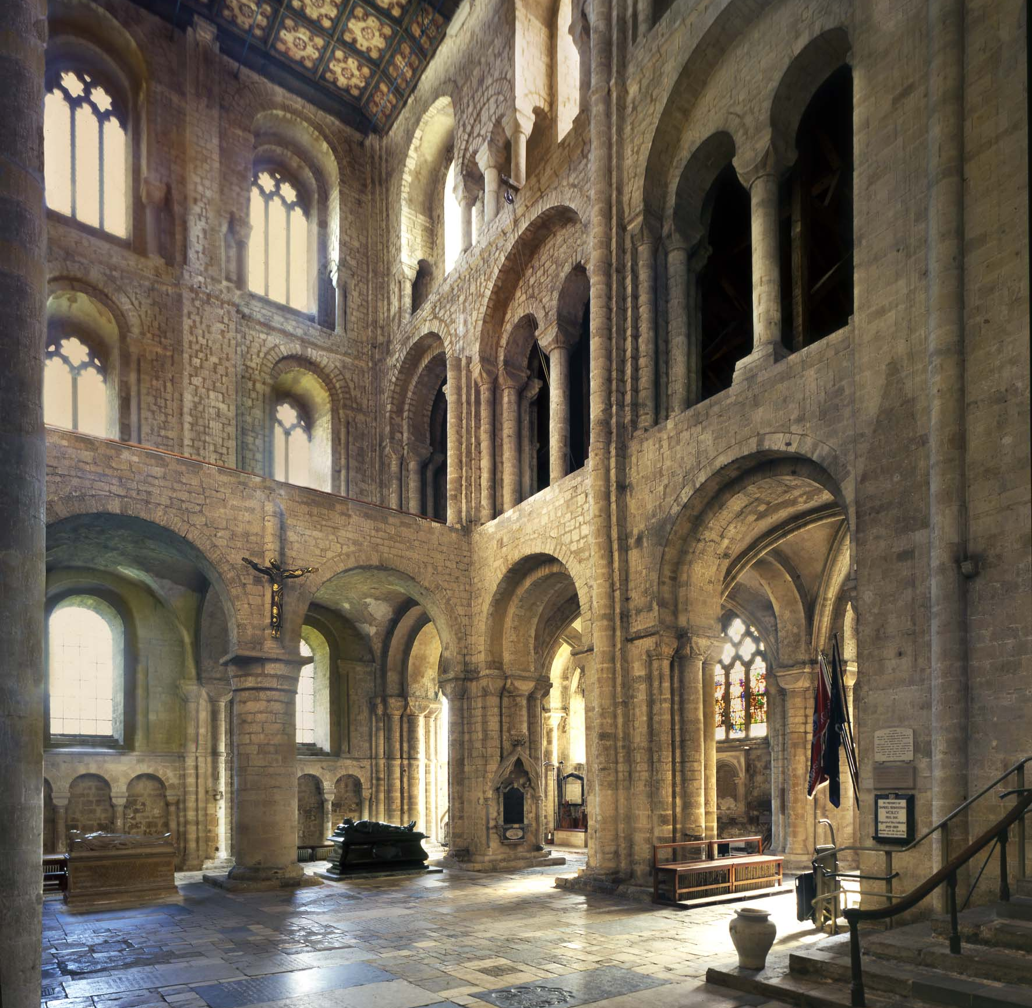
Conservation & interpretation of collections and Cathedral Fabric
Notes:
As part of my role, I work with a great team of colleagues and volunteers, including our Cathedral Archaeologist and Architect, our Visitor Experience Manager and Virgers, our Learning Department and Head of Development. Together, we work to ensure the conservation and interpretation of collections and fabric of the building.

Slide 5
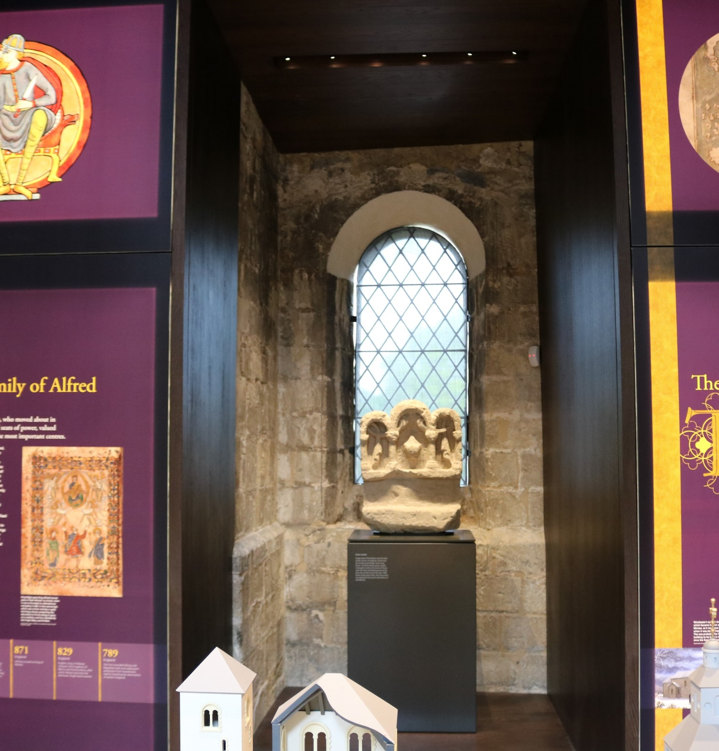
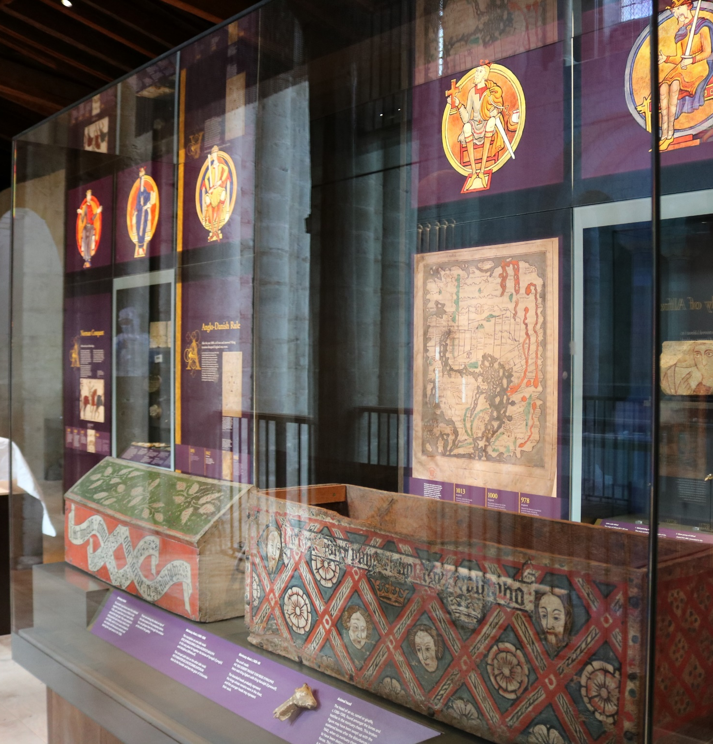
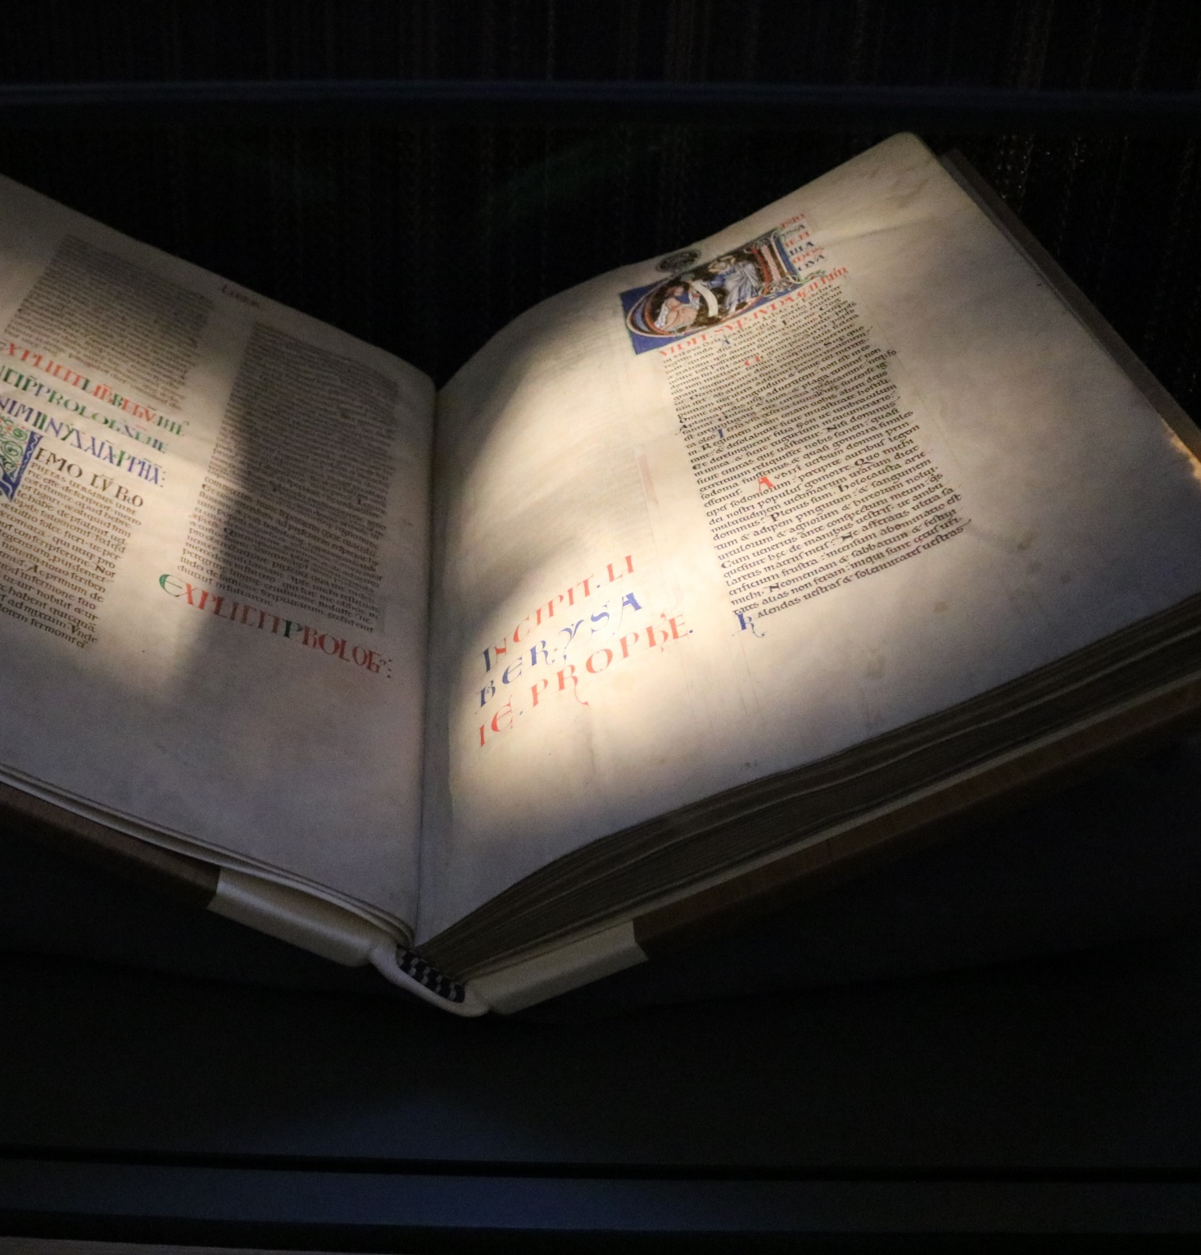
Kings & Scribes Exhibition
Opened 2019
Notes:
A selection of our most important objects are on permanent display in the Kings & Scribes exhibition, located in the South Transept. Supported by the Heritage Lottery Fund, Kings & Scribes is a multi-sensory, interactive exhibition over three floors. On the far side, you can see one of the volumes of the Winchester Bible, one of the most important 12th-century manuscripts of its kind and at the very heart and centre of our collections here.

Slide 6
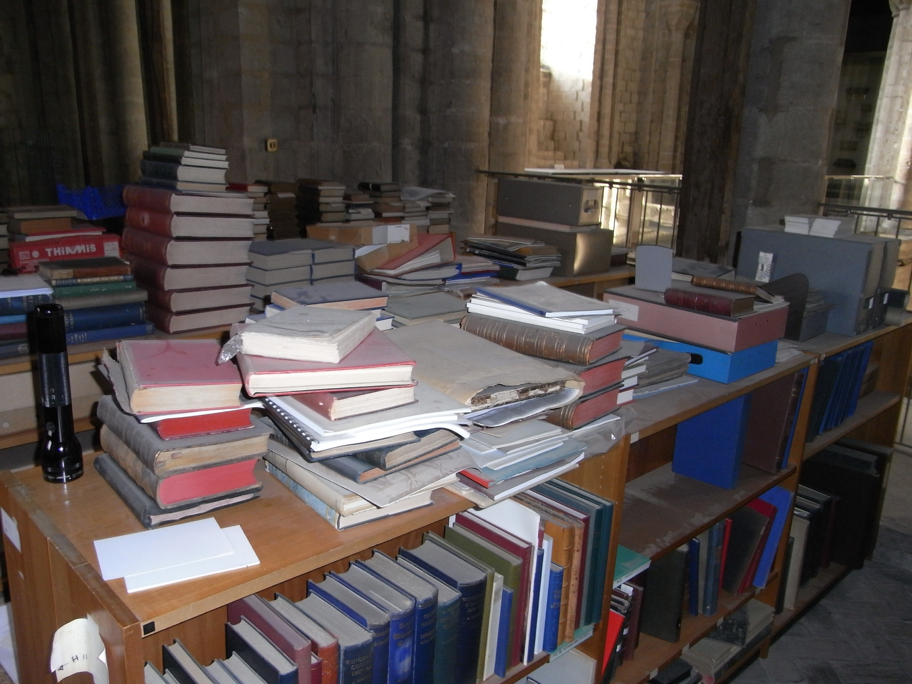
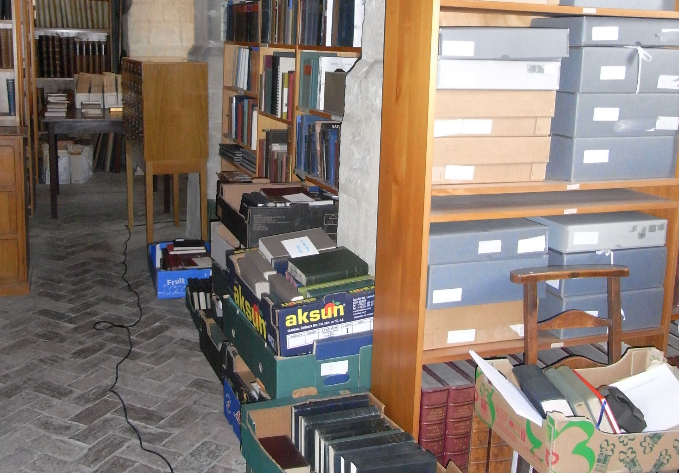
South Triforium prior to HLF works
Notes:
As you can imagine, the amount of work which went into the planning and implementation of the Kings & Scribes exhibition took many years to realise. Here you can gain a little sense of what the South Triforium looked like prior to the exhibition.

Slide 7
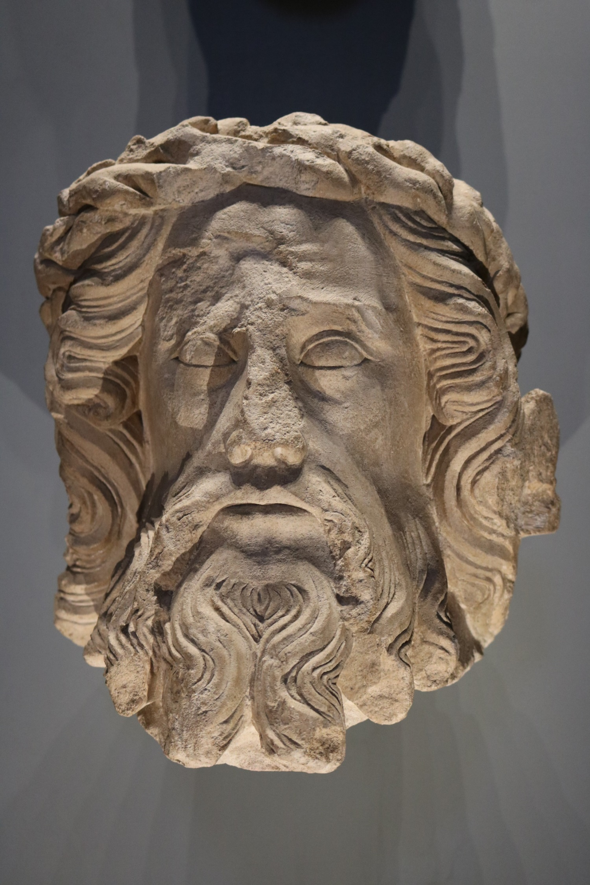
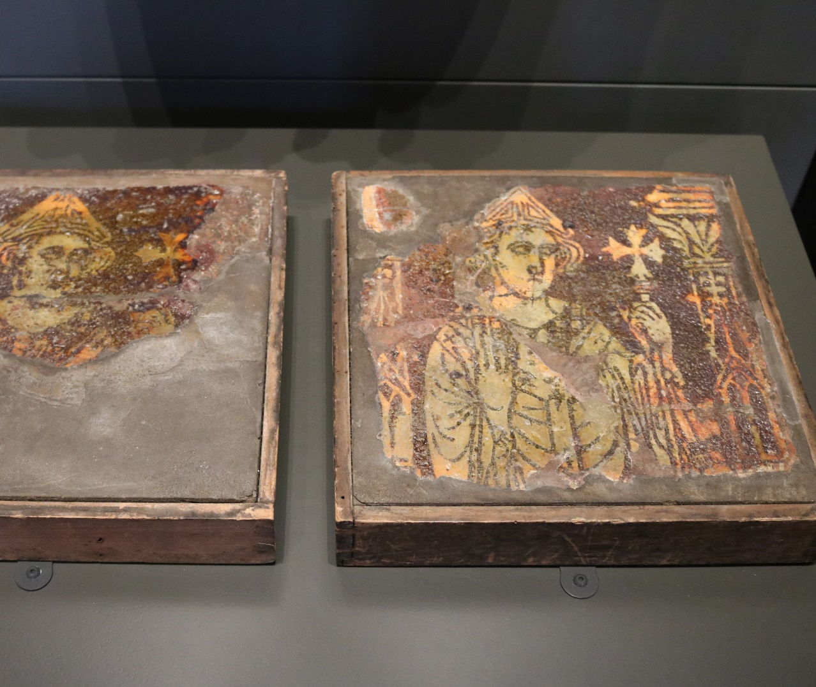
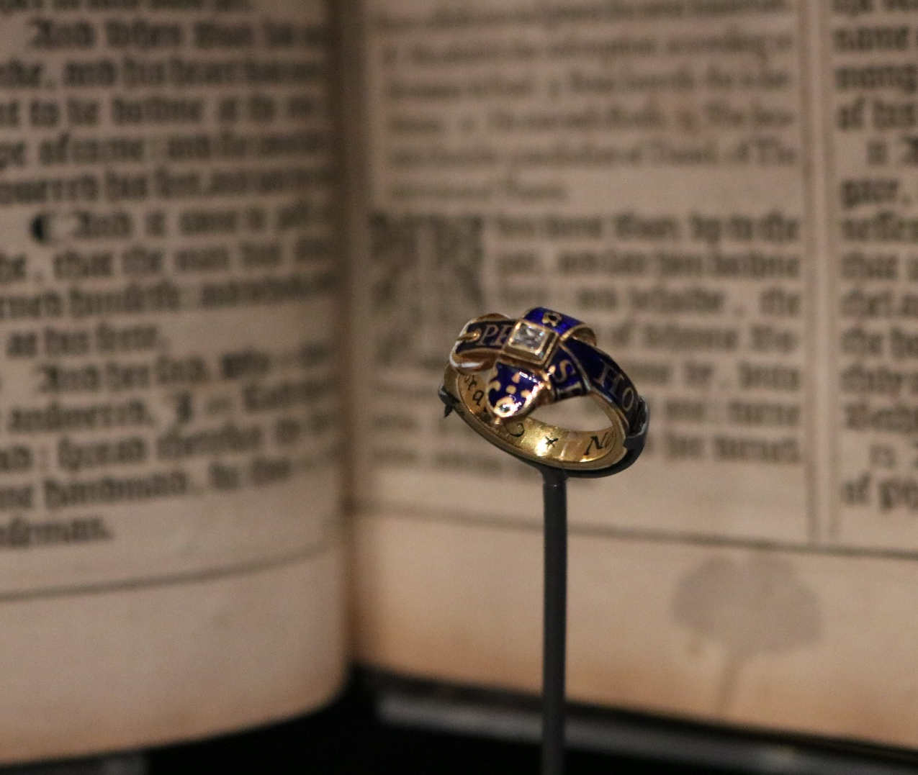
Exhibition situated within the Cathedral, but distinct from it
Notes:
As with all exhibitions and museum displays, the makeup of Kings & Scribes is an artificial selection designed to tell a story about the history of the Cathedral. The exhibition is located inside the Cathedral and I think this location is important, because it means that visitors are continually reminded as they move around the exhibition of the context in which the exhibition exists. This is especially true on the South Triforium level, which is the highest level – from here, it is possible to look out across the main body of the Cathedral towards the choir, which is very visually impressive. Depending on when you visit, you may also be reminded of the work of the Cathedral through the sound of organ practice or prayers or people simply moving around below. Kings & Scribes is very much a distinct and separate space, but it is never entirely removed from the Cathedral.

Slide 8
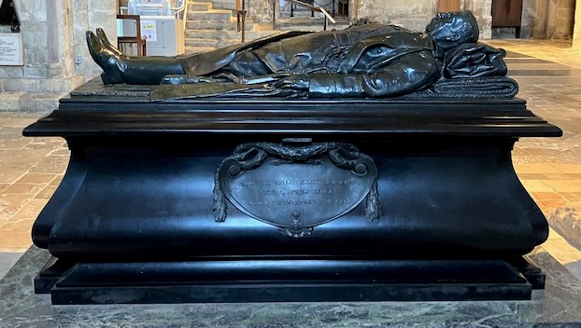
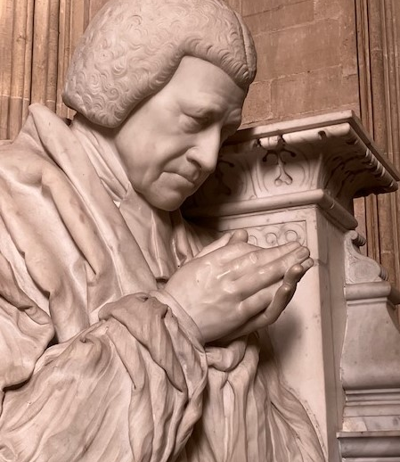
Contested Heritage
Notes:
Now I mentioned earlier that we share many of the same interests and issues as other heritage organisations, be that conservation, cataloguing, visitor experience, learning, engagement, interpretation or development. To finish, I thought I would just add a short bit about the ongoing work we are doing around contested heritage. As with many places, contested heritage is something which has become of growing concern for us in the past few years and for cathedrals more broadly. In 2021, the Church of England published guidance on responding to memorials and objects of a contested nature. Since then, we have established a programme of research and over recent weeks, have held a series of informal discussion workshops involving staff, volunteers and external partners from the University of Winchester to debate some of the themes and questions which contested heritage raises. Though not an answer in and of itself, we hope the workshops are at least a jumping off point for exploring this area and developing better interpretation around it in the future.

